Slide 1

The light of science and technology, make the life colorful

Slide 2
目录
CONTENTS
01
Company profile
02
Lighting products
03
Backlight indicating products
04
Subdivision products

Slide 3
01
Company profile

Slide 4
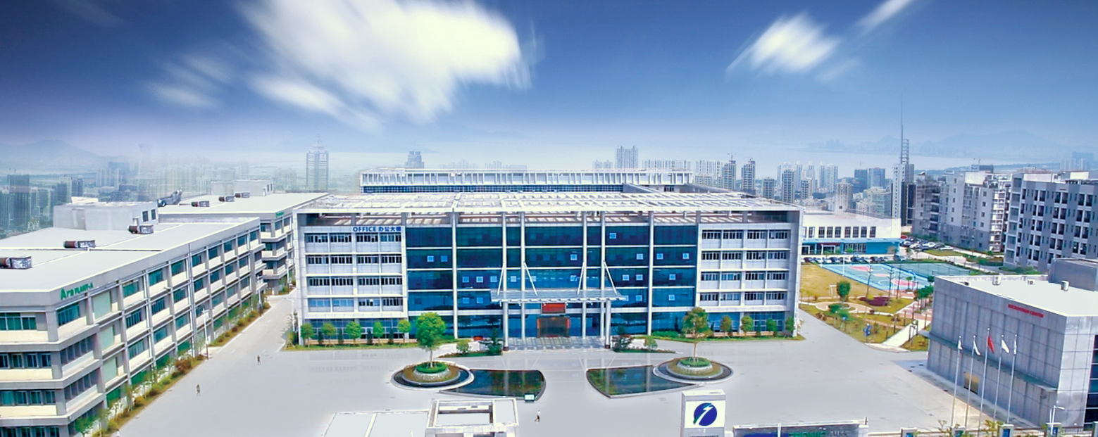

Group Profile
Established
2004/05
Founder
Guoping Li
Business area
Semiconductor Packaging: , White LED
, Mini/Micro LED, LED brackets
Automotive Lighting: Automotive lamp (Commercial Vehicles & Passenger Vehicles), Automotive LED
Other fields: General lighting, city & landscape lighting
Registered Capital
710 Million RMB
Number of Employees
4000+

Slide 5


Milestone
2020
The first prize
2018 Luzhou
Laojiao Group
The first prize of national science and technology progress award.
Luzhou Laojiao Group became the controlling shareholder of Honglizhihui in 2018 to enhance the company's strength and brand effect.
2011 IPO
The company was listed in Shenzhen Stock Exchange, stock code is 300219, step on the road of rapid development
2004 Establish
Hongli Opto-electronics was estabilished and the headquarter is in Guangzhou, China.Hongli is specialized in R&D and production of semiconductor packaging products.

Slide 6
Group Revenue
In recent years, in the face of the severe and changing international situation, the company has forged ahead, actively promoted various work, and cultivated new business and profit growth points. In 2023, the company stabilized the market share of the main packaging industry, accelerated the market penetration of new displays and automotive lighting, and ensured the stable development of the business, achieving an operating income of 3.759 billion yuan. （522 million USD）
(Unit/ Million RMB)
(Year)
2011 2012 2013 2014 2015 2016 2017 2018 2019 2020 2021 2022 2023

Slide 7
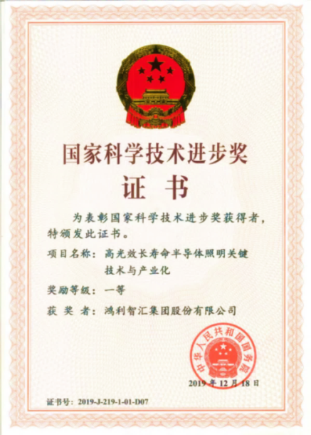
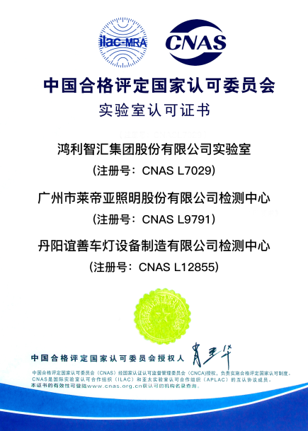

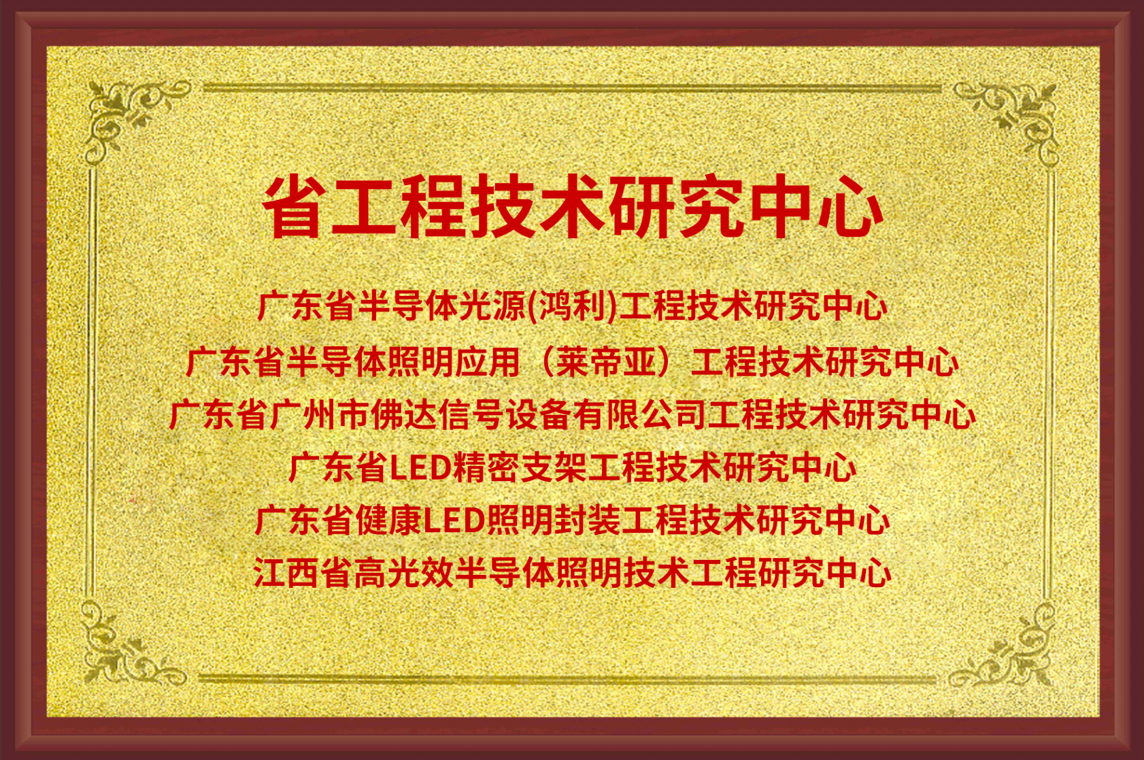
R&D Technology
The first prize of national science
and technology progress award
National Torch Program Key High-tech Enterprise
Independent research and development, annual research and development investment accounts for 4%-6% of revenue.
6 provincial engineering technology research centers.
3 National Accreditation Commission (CNAS) laboratories
授权专利
940项
发明专利
165项
（专利数据截止至2022Q4）

Slide 8
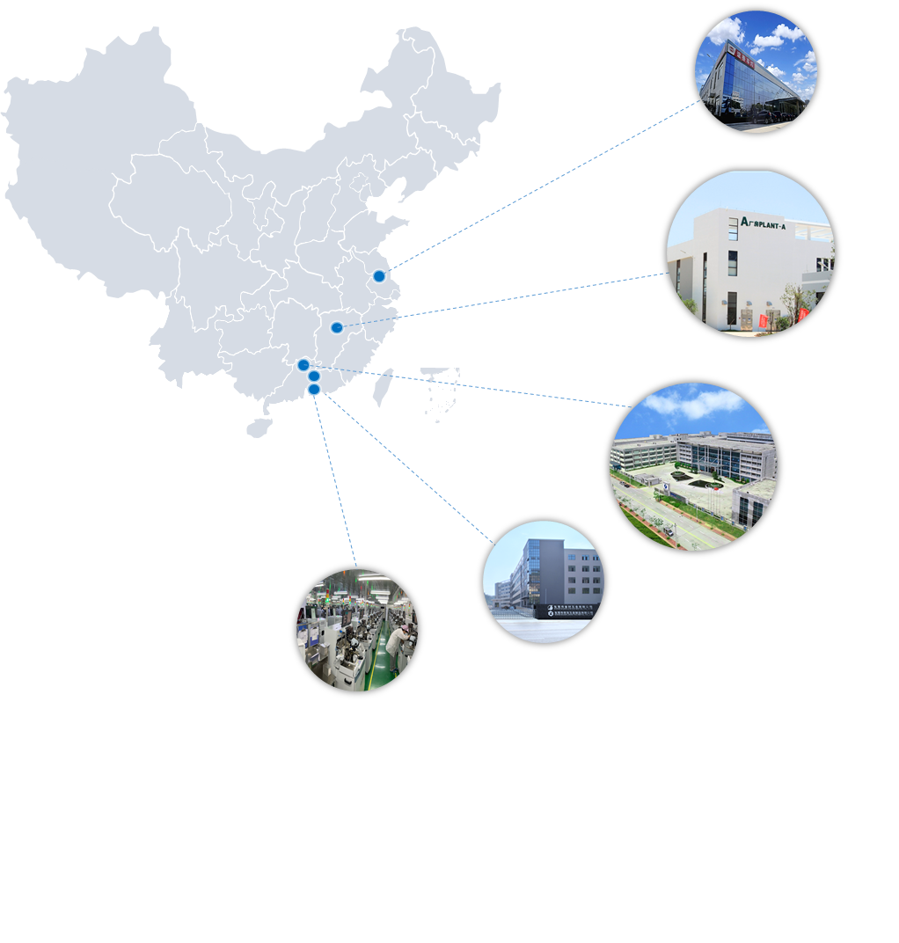
Production Base
Production base
Guangzhou Base
100,000㎡ semiconductor packaging base
12,600㎡ Mini/Micro LED production base (Phase I)
178,400㎡ Mini/Micro LED production base (Phase II under construction)
25,000㎡ Automotive Lighting production base
Zhenjiang
Nanchang
Nanchang Base
60,000㎡ Semiconductor Packaging Production Base (Phase I)
130,000㎡ semiconductor packaging production base (Phase II under construction)
Guangzhou
Shenzhen base
6,000㎡ semiconductor packaging production base
Dongguan
Dongguan Base
70,000㎡ LED bracket production base
Shenzhen
Zhenjiang Base
14,500㎡ automotive lamp production base

Slide 9
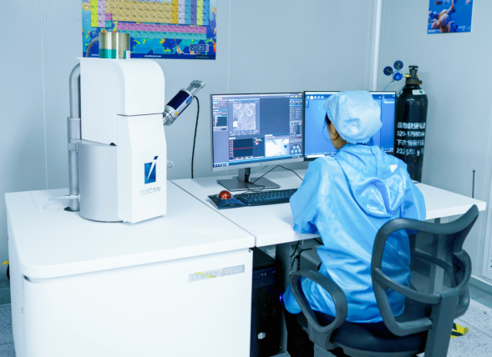
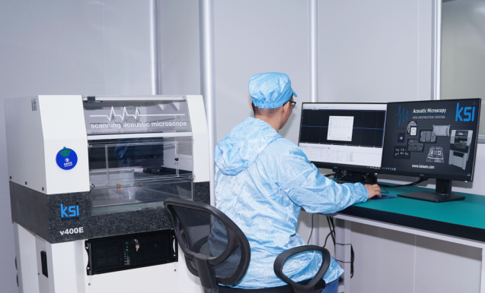
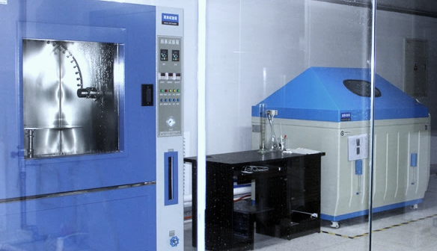
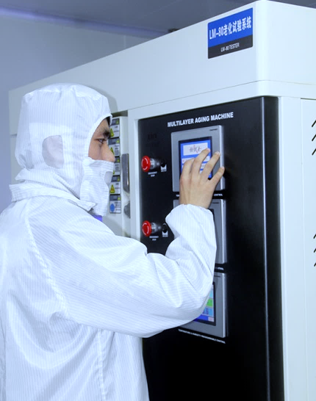
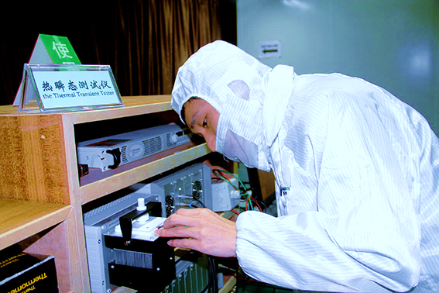
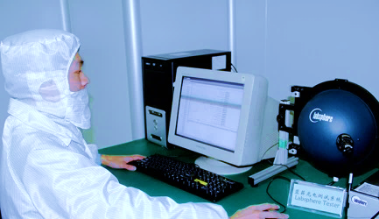
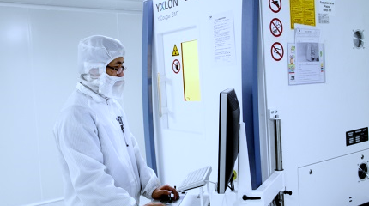
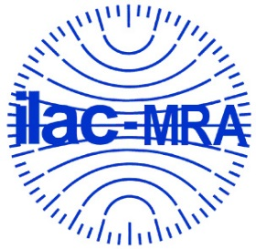

CNAS Lab(Energy Star)
Advanced Equipment
SEM
SAM
Environmental test
LM-80
T3ster
Lanfei optical tester
X-RAY
LM-80 Aging Testing Lab
Reliability Testing Lab
Our laboratory is CNAS (CNAS LAB CODE L7029) accredited, also recognized by US EPA for LED Packages/Arrays/Modules IES LM-80 testing and CIE 127-2007 standard testing.
Environmental test, Lanfei optical tester, X-ray, Keyence, T3ster and other test equipment.
By using advanced equipments (including SEM、SAM、DSC、T3ster、Infrared temperature distribution measuring instrument、Steady state photoelectric parameter spectrometer、Fluorescence analysis instrument…etc), encapsulation materials such as phosphor and product internal structure analysis can be analyzed to enhance product performance.
Material Analysis Lab

Slide 10







Sales Network
International distributors & Domestic sales centers
Our product has covered more than 40 countries and regions in the world
The subsidiary company Forda set up a branch in the United States for expanding the European and American markets.
Forda American branch
Domestic sales center locations
Shenzhen, Jiangsu, Zhejiang,
Fujian, Sichuan
Sales: 200+
Domestic lighting customers: 3000+
International distributors locations
Korea, Russia, Brazil.....

Slide 11
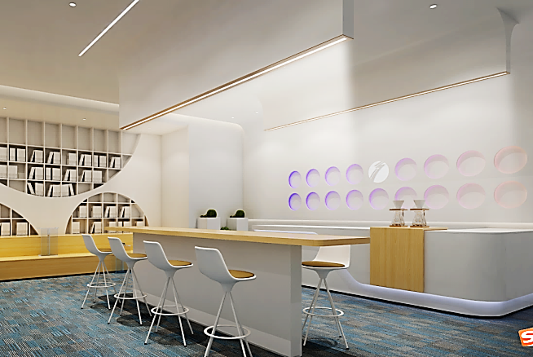
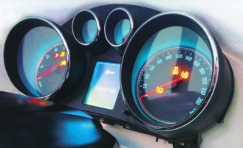
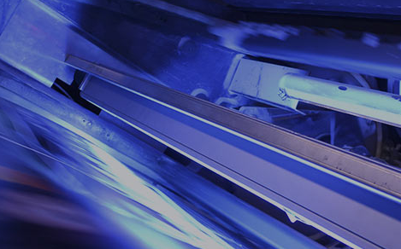

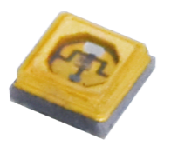
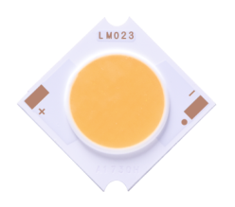

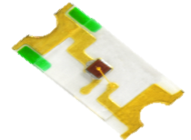
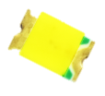
主营产品 Main products
General lighting
indicating backlight
其他领域 Other area
Backlight products, indicating products
Automotive lighting, plant lighting, UV curing, UV elimination, etc
Health lighting, indoor/outdoor/commercial lighting

Slide 12
02
Lighting products

Slide 13
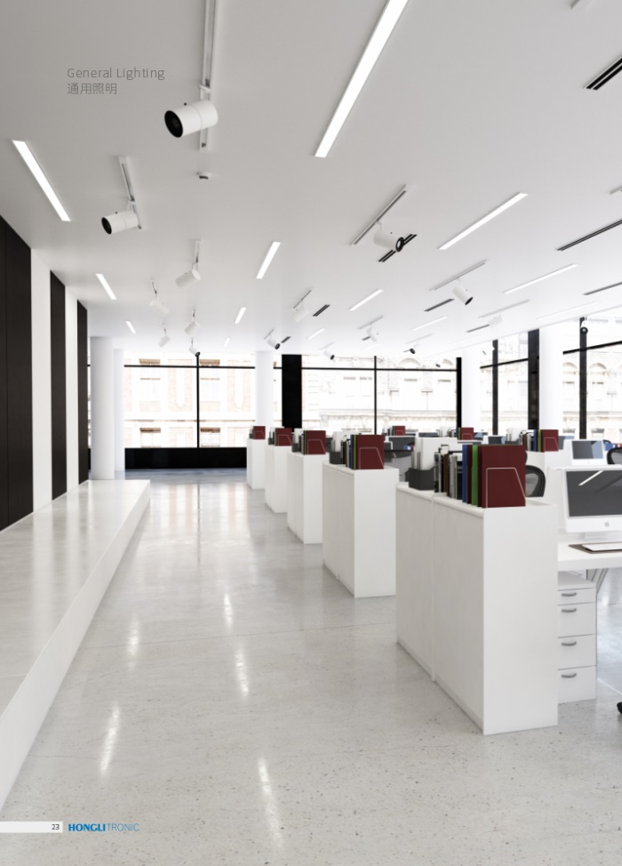
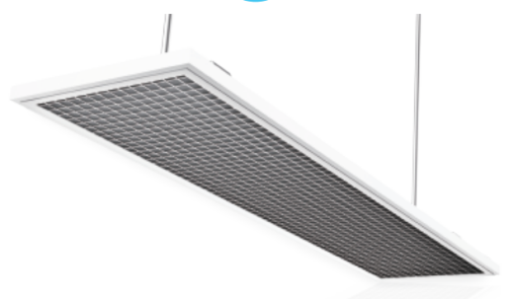
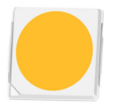
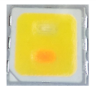
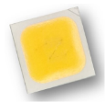
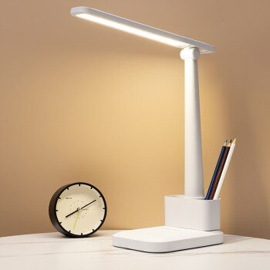
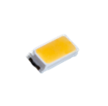

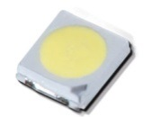


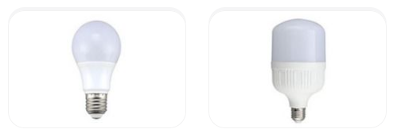
SMD LED
3030PCT
bi-colour 3030PCT
EMC3030
4014
3014
ES3030
2835PCT
2835PPA
0.1W 0.2W 0.5W 1W 2W Watt

Slide 14
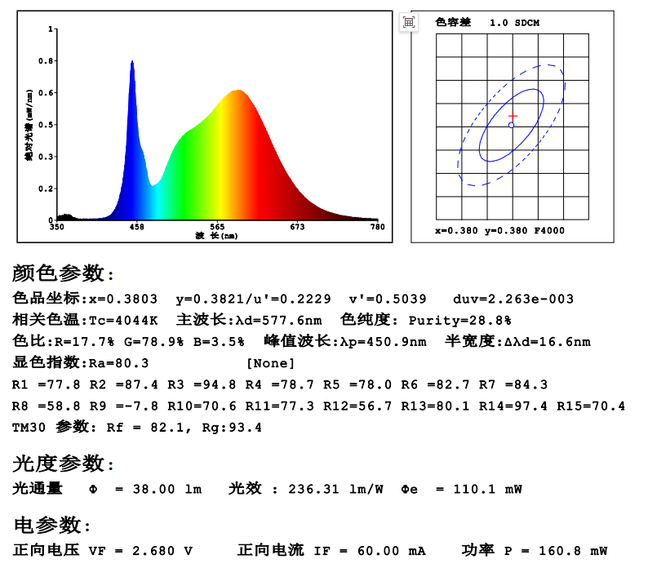

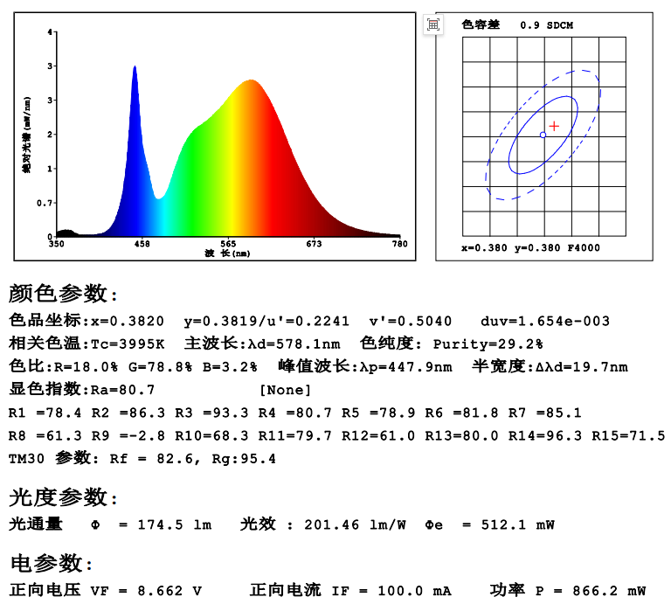

SMD LED-High light efficiency products
0.2W | 0.5W | 1W

Slide 15

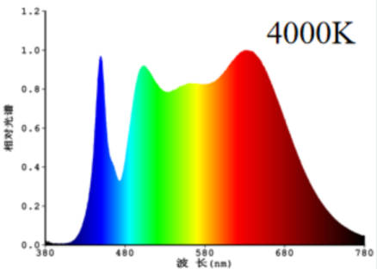
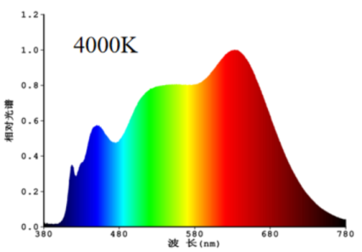
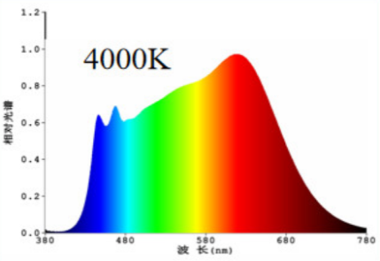
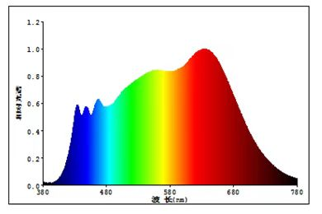
SMD LED-High CRI products
Hongli Health Lighting Series 2.0 products adopt the technical scheme of multi-band chip excitation special phosphor. Compared with the existing double blue light excitation phosphor scheme, the light efficiency is improved by 3.5%, the absolute spectral intensity of blue light is 30%-40% lower than that of conventional products with the same color temperature, and the harm level of blue light can reach RG0. And spectrum saturation at 480nm, full of certain rhythm effect, in the aspect of technological innovation has obtained 3 patents.
升级
NEW
健康照明方案 | 单蓝光芯片全光谱 | 紫光芯片全光谱 | 双波蓝光芯片全光谱 | 健康照明系列2.0
光谱分布
光效 | ★★★★ 165lm/W | ★ 130lm/W | ★★150lm/W | ★★★155lm/W
全光谱 | ★★（蓝绿光区域存在鸿沟） | ★★★★ | ★★★ | ★★★★
显色指数 | ★★★ CRI≥95,R9≥90 | ★★★★ CRI≥97,R1-R15≥90 | ★★★★ CRI≥97,R1-R15≥90 | ★★★★ CRI≥97,R1-R15≥95
光生物安全 | ★（高色温蓝光辐射功率大） | ★★（UV辐射） | ★★★ | ★★★
调节人体节律 | ★（480-490nm不足） | ★★★ | ★★★ | ★★★
性价比 | ★★★★ | ★（成本高、光效低） | ★★★ | ★★★
升级
4000K

Slide 16
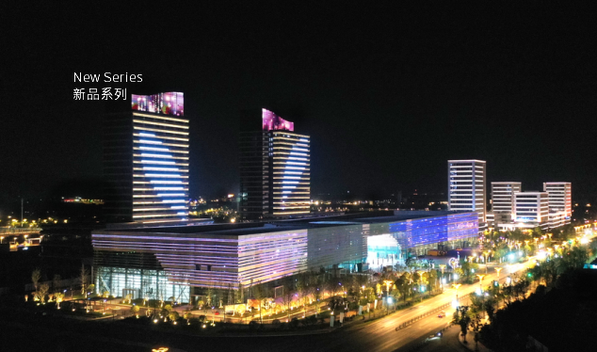

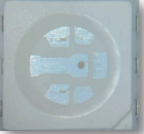
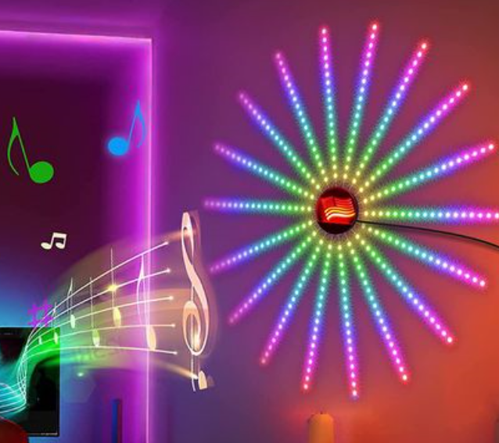

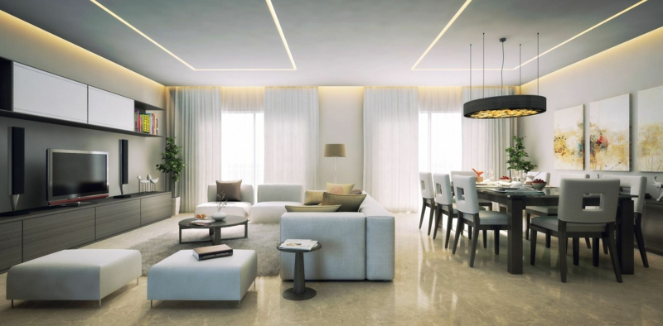
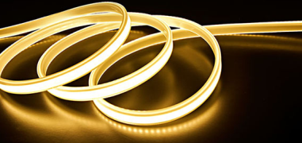

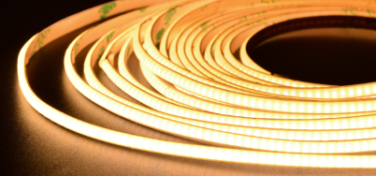
SMD LED-Light strip/light bar application
Outdoor/indoor light strip/light strip applications
Light strip/light bar
SMD LED
5060RGB
PPA2835
PPA2219
0.1W 0.2W 0.5W Watt

Slide 17
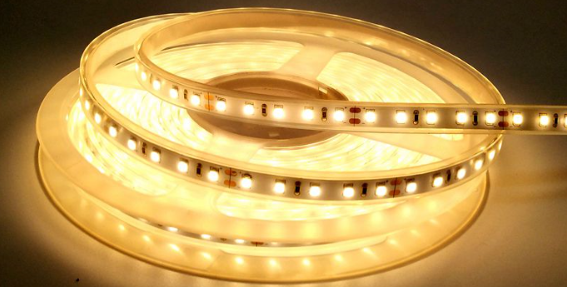
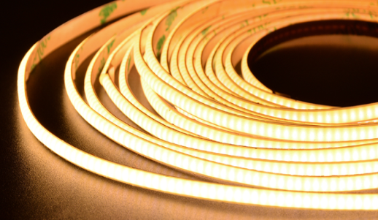
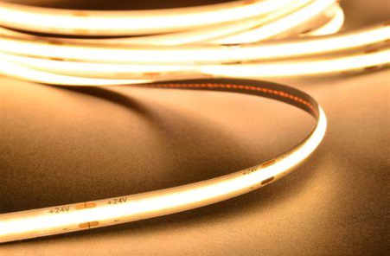
SMD LED-Light strip product
NEW
PPA2219
Ultra-small size to meet the high light density requirements ；
Linear luminescence, no dark areas, color consistency against the COB light strip ；
High reliability: Thermal Shock test can pass 300 rounds ，High temperature of 85℃/1000H maintenance rate is 99%
Normal light strip
2219 light strip
COB light strip
Item no. | VF | Ra | IF(mA) | 4000K (Typ lm/w) | IF(mA)MAX
A2219W3H2-D01-8D2AB2 | 3V | 80 | 60 | 145 | 90
A2219W3H2-D01-9D2AB2 | 3V | 90 | 60 | 135 | 90

Slide 18
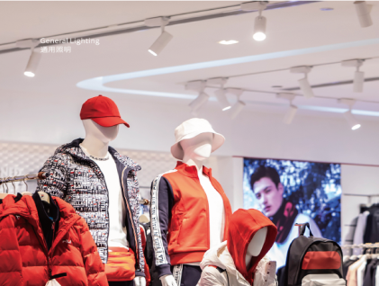
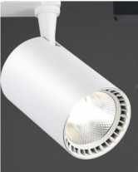
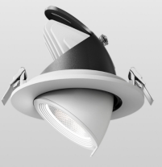
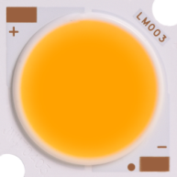

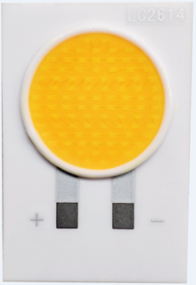

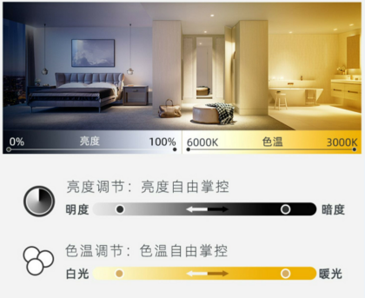





COB LED
General Lighting - Commercial lighting
LM series Sedimentation technology,high light efficiency
LM-HI series Small luminous surface Highlight density
LC series
Sedimentation technology Class II luminaire
LH series
HightCost performance ratio Class Ⅰ and Ⅱ luminaire
Track lamp Spot light
Smart Dimming - Commercial lighting
Spot light Floor lamp
LH-CS series Uniform light output
LM-DS系列
光效高
LM-DS series High Luminous efficiency
LH-RGBWW Series
RGBWW Five-way dimming

Slide 19



COB LED-High light efficiency products
Product feature
1、 High reliability, Pass 10000 hours LM-80 test, TM-21 life expectancy L70 > 6000hours ；
2、 Size, luminous area can be compatible with the general market lamp fittings ；
3、 Good color consistency, 3 - Step McAdam ellipse sorting .
Product Type | Dimensions | Rated Current/mA | Standard voltage/V | Typ.efficiency (lm/w) | /Tc | Ra | Maximum current/mA
LMH02D90W-9B4C12(Ra4)-S | 13.50×13.50mm （LES φ11.2mm） | 360 | 35 | 130 | 3000K | 90 | 600
LMH03D90W-20B10C12(Ra4)-S | 19.0×19.0mm （LES φ17.0mm） | 900 | 35 | 125 | 3000K | 90 | 1200
LMH04D90W-60B18C18(Ra4)-S | 28.0×28.0mm （LES φ24.5mm） | 1620 | 35 | 125 | 3000K | 90 | 2700

Slide 20



COB LED-High voltage products
Product feature
Ceramic leadframe, electrical spacing and Hi-Pot test meet GB7000.1-2015 standard requirements ；
High reliability, Pass 10000 hours LM-80 test, TM-21 life expectancy L70 > 6000hours ；
Good color consistency, 3 - Step McAdam ellipse sorting.
Test condition：I≤5mA
T=60s Alternating voltage
Product Type | Dimensions | Rated Current/mA | Standard voltage/V | Typ.efficiency (lm/w) | Tc | Ra | Maximum current/mA
LC2009D4W-18B1C36(Ra4)-S | 16.0×19.7mm （LES φ8.5mm） | 150 | 108 | 94 | 3000K | 90 | 170
LC2611D4W-24B1C54(Ra4)-S | 17.25×25.6mm （LES φ11.5mm） | 150 | 162 | 99 | 3000K | 90 | 170
LC2614D4W-50B2C54(Ra4)-S | 17.25×25.6mm （LES φ14.0mm） | 300 | 162 | 95 | 3000K | 90 | 170

Slide 21






COB LED-Dual-Color Adjustable COB
High-density features:
High-density: minimum chip spacing is 0.18mm
High power: surface diameter of 11mm, power of 28watt.
High-light features
High-light efficiency : mirror aluminum substrate
& chip coating process, light efficiency increased by 15%.
High-density:
High-light efficiency
uniformity of light spot
类型 Type | Product Type | 尺寸 Dimensions | 电流/mA Rated Current/mA | 标准电压/V Standard voltage/V | 输入功率/W Input Power/W | 色温/Tc | 典型光效/lm/W Typ.efficiency (lm/w) | 显色指数/Ra | 最大电流/mA Maximum current/mA
高光密 High-density | LH1308F95W-9B2C12(Ra4)-FC-DS | LH1308 13.35×13.35mm （LES φ8.0mm） | 250 | 35 | 8.8 | 2700 | 86 | 90 | 350
 |  |  |  |  |  | 6000 | 110 | 90 | 350
 | LH1611F95W-18B4C12(Ra4)-FC-DS | LH1611 15.85×15.85mm （LES φ10.5mm） | 600 | 35 | 21.0 | 2700 | 87 | 90 | 750
 |  |  |  |  |  | 6000 | 113 | 90 | 750
高光效 High-light efficiency | LM1311D4W-12B4C12(Ra4)-DS | LM1311 13.35×13.35mm （LES φ11.0mm） | 150 | 72 | 12 | 3000 | 95 | 90 | 170
 |  |  |  |  |  | 5700 | 105 | 90 | 170
 | LM1311D4W-12B2C24(Ra4)-DS |  | 300 | 36 | 12 | 3000 | 95 | 90 | 170
 |  |  |  |  |  | 5700 | 105 | 90 | 170

Slide 22











Elevator lighting application
General lighting - Panel lights | Key indication -chip series
local light field -Down light | mini LEDs Display - LCD /mini
Emergency light - Down light | □Air purification & sterilization
6
2
3
1
1
1
6
5
2
3014 4014 3528
2012 1608 2012
5
4
4
3030 2835
3030 2835
C3535UVA C3535UVC
Elevator lighting

Slide 23
Application for Elevator lighting specifications
正常照明-面板灯 | General lighting - Panel lights 型号 P/N | 色温CCT(K) | Φ(lm) |  | Ra | VF(V) |  | IF(mA)
 |  |  | Min | Typ |  | Min | Max
 | A-4014H466W-S1-HR3-DM-HL(R9) | 3000 | 25 | 27 | 80 | 2.6 | 3.2 | 60
 |  | 6500 | 27 | 29
 | A-3014H421W-S1-08HL-HR3 | 3000 | 13 | 14 | 80 | 2.6 | 3.2 | 30
 |  | 6500 | 14 | 15
 | AS-3528H421W-3C-S1-08L-PCT-HR3(R9)-R1 | 3000 | 115 | 125 | 80 | 8.6 | 9.6 | 100
 |  | 6500 | 125 | 135
局部照明-筒灯 紧急照明-筒灯 | Application for Down light 型号 P/N | 色温CCT(K) | Φ(lm) |  | Ra | VF(V) |  | IF(mA)
 |  |  | Min | Typ |  | Min | Max
 | AS-2835D1W-3C-S1-08L-PCT-HR3(R9) | 3000 | 125 | 135 | 80 | 8.4 | 9.6 | 100
 |  | 6500 | 130 | 140
 | ES-3030D46W-2C-S1-HR3 | 3000 | 128 | 133 | 80 | 5.8 | 6.6 | 150
 |  | 6500 | 140 | 145

Slide 24
Application for Elevator lighting specifications
按键指示-chip系列 | Key indication -chip series 型号 | 色温(K)/ CCT发光颜色 | Φ(lm) |  | VF(V) |  | IF(mA) | 分光方式 Color Test
 |  |  | Min | Typ | Min | Max
 | PST-1608H233W | 9000-16000K | 600 | 650 | 2.7 | 3.3 | 10 | 套筒
 |  | 6000-7000K | 600 | 700
 | PSC-2012H233W | 9000-16000K | 1000 | 1400 | 2.8 | 3.4 | 20 | 套筒
 |  | 6000-7000K | 1000 | 1500
 | PSC-2012S9AC | Red | 90 | 150 | 2.6 | 3.4 | 20 | 积分球
□空气净化&杀菌 | Air purification & sterilization 型号 | 发光角度View Angle | 峰值波长nm wavelength | Φe(mW) |  | VF(V) |  | IF(mA)
 |  |  |  | Min | Typ | Min | Max
 | C3535F7V365-D1-LVR9 | 60/120 | 360-370 | 380 | 420 | 3.2 | 3.8 | 500
 | C3535D01V280-D1-LVR17-L | 120 | 270-280 | 12.5 | 15 | 5.6 | 6.4 | 100

Slide 25
03
Backlight indicating products

Slide 26













CHIP Series - Backlight indicating products
Backlight indication
Backlit indicator module
CHIP series
0606(1617)
0603(1608)
0805(2012)
1204(3010)
1206(3216)
Automotive dashboard
0603(1608)
0805(2012)
1204(3010)
1206(3216)
Household appliance
display
Elevator button
0.02W 0.03W 0.04W 0.05W 0.06W Watt

Slide 27





CHIP Series - Products performance enhancement route
① LM-80 test，lifetime ＞54000H
Based on the reliability test conditions of LED certified
in the electrical appliance industry, the internal test results
are as follows:
② Passed reliability test of military《 GJB548B 》
①
②
Test Items | Product reliability
 | Test Condition | result
Thermal Shock | -40~125℃ | 500Cycle-0K
lifetime at high Temperature | Ta=70℃，IF=20mA，T=1000H | 72%
硫化实验 sulphur test | 85℃/4H | 99.7%
红墨水实验 Red-ink test | 100℃/2H | impermeability
High temperature and high humidity pulse experiment | The current was 0.4 times of the maximum forward pulse current, pulse condition was 1kHz, duty ratio was 1/7, and the remaining 2/7 duty ratio was randomly applied 8V±0.5v reverse voltage | 92.54%
High temperature pulse experiment | Ta=70℃±2℃; The current size is 0.8 times the maximum forward pulse current; Pulse frequency 1KHz, duty cycle 1/7, time 1000H | 89.5%

Slide 28
04
Subdivision products

Slide 29











Outdoor/ Vehicle lighting Products
Application
General lighting
Outdoor/industrial lighting
C2525系列 Series
高功率1-3W
高可靠性
Power 1-3W (2.5*2.5mm)
C3535系列 Series
高功率1-5W
高可靠性
Power 1-5W (3.5*3.5mm)
Flood light High bay light
投光灯 工矿灯
Vehicle lighting
Headlights, turn signals, indicator lights
C1860系列Series
高功率15W
明暗截止分明
High-power 15W
C7035系列Series
高功率27W
明暗截止分明
High-power 27W
LED大灯 LED转向灯
Headlights Turn Signals
C2017系列 Series
高功率密度
C3535系列Series
功率1-3W
Power 1-3W

Slide 30




Outdoor / Vehicle lighting Products
Application: ultra bright flashlight, searchlight, vehicle light.
NEW
Advantages: High luminous intensity per unit area irradiation at long distance, high power, high-temperature resistance.
C3535实物图
3.5*3.5mm
C35050实物图
5.0*5.0mm
产品型号 P/N | 尺寸 Dimension | 电压 Voltage (v) | 光通量 lumen Typ. | 显色指数CRI/Ra | 最大电流mA (max) | 最大功率Watt (max)
C3535F66W5PB（Ra1)-L | 3.45*3.45 | 3.2 | 580@2000mA | ≥67 | 3000 | 5
C5050K38W10PB(Ra1)-L | 5.0*5.0 | 3.2 | 620@2000mA | ≥67 | 6000 | 10

Slide 31














Specialty lighting- Horticulture
LEDs Lighting lamp
Plant LEDs Source
Application for Horticulture lighting
C3535植物照明系列 3.5*3.5mm Series
PCT2835系列植物照明系列 2.8*3.5mm Series
白光
White
蓝光 Blue
红光 Red
红外 Infrared
紫外 Violet
High reliability- The whole series of products have passed the Q90 certification, the lifetime more than 54000hrs

Slide 32















UV LEDs Series
G7070
Air purification
UV LED curing printing ink
UV LED 3D Printing
C3535
G3535
Home-light therapy instrument, hospital- local irradiation phototherapy instrument, systemic phototherapy equipment
C3535
C3535
Sterilized water cup
Mite removal instrument
air sterilization
Toothbrush sterilizer
UVC:280~200nm
UVB:280~315nm
UVA:315~400nm

Slide 33



深紫外产品应用案例 UVC LEDs Project
Application: Elevator handrail sterilization- Public place
Elevator handrail: 82mm, Handrail belt moving speed: 0.5 m/s.
Panel
handrail
Quartz glass
 | Plan 1: Kills 99% of germs | Plan 2: Kills 90% of germs | Plan 3: Kills 99.99% of germs after 44 minutes of operation.
灯珠数量 LEDs QTY | 48颗（单颗15mw） 48pcs ( 15mw/pc) | 48颗（单颗28mw） 48pcs ( 28mw/pc) | 9颗（单颗15mw） 9pcs (15mw/pc)
杀菌率 Bactericidal rate | 92.75% | 99.27% | 99.99%

Slide 34



UVC LEDs Project
Design instructions
Using 9pcs UVC-LEDs, through optical simulation display , the ultraviolet radiation intensity is 1.5mW/cm2, and the sterilization rate of the elevator handrail is as high as 99.9% after 47 runs.
模组总光功率 Totally Power of module | 平均辐射强度mw/cm2 Average radiation intensity | 扶梯运行圈数(次) escalator running cycles (times) | 照射时间（累计）s cumulative irradiation time(S) | 紫外剂量mJ/cm2 UV irradiation dose | 杀菌率 sterilization rate
135mw | 1.5 | 47 | 9.4 | 14.1 | 99.99%
Third party test report of escalator sterilizer

Slide 35




